Slide 1


E-commerce Sales Analysis Project
This project analyzes e-commerce sales data using machine learning techniques to identify key trends, customer behaviors, and generate actionable insights. This project demonstrates the power of data analysis to inform business decisions and drive growth.
NAME : Veeramanikandan K R
NM ID : au910021114047
COLLEGE : Anna University Regional Campus Madurai
BRANCH : B.E-Mechanical Engineering

Slide 2

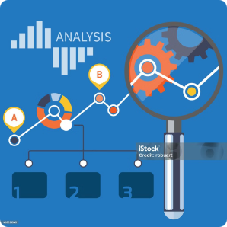

Introduction and Project Goals
1
Project Overview
2
Key Sales Metrics
3
Actionable Insights
This project aims to gain insights into e-commerce sales data, leveraging machine learning techniques to uncover meaningful patterns and trends.
The project focuses on identifying key sales metrics such as total revenue, best-selling products, and customer purchase behavior.
The goal is to generate actionable insights that can be used to improve business strategies, optimize operations, and drive revenue growth.

Slide 3
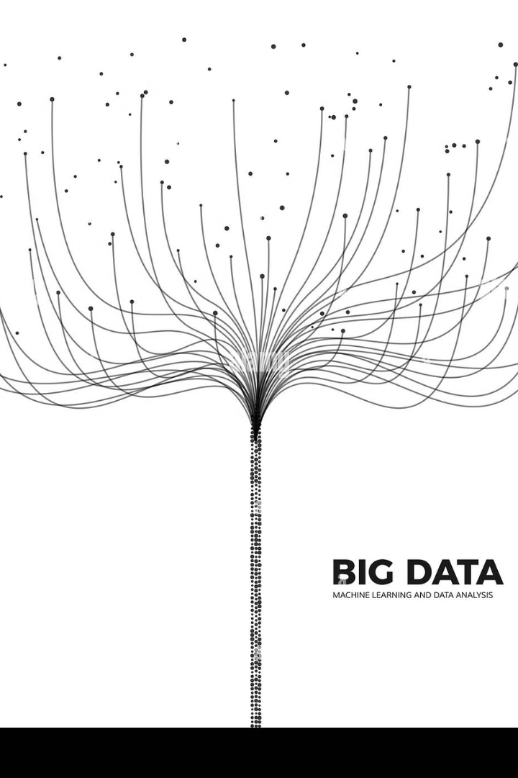
Dataset Overview and Data Preparation
Column
Data Type
Description
Order ID
Integer
Unique identifier for each order
Customer ID
Integer
Unique identifier for each customer
Product ID
Integer
Unique identifier for each product
Order Date
Date
Date of the order
Quantity
Integer
Number of items ordered
Price
Float
Price of each item

Slide 4

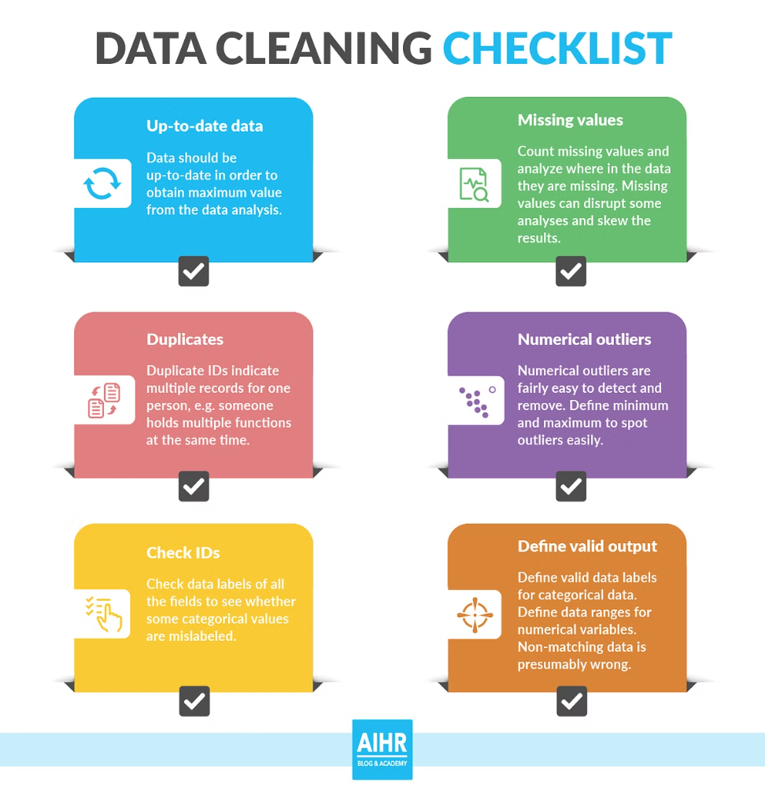
Data Cleaning
1
Missing Values
Missing values were handled by replacing them with the median value for numerical columns and the mode for categorical columns.
2
Data Types
Data types were converted to appropriate formats, such as converting order date to a datetime object.
3
Duplicate Removal
Duplicate rows were identified and removed to ensure data integrity and accuracy.

Slide 5

Key Metrics - Total Sales and Best-Selling Products
Total Sales
Best-Selling Products
Total sales were calculated by multiplying quantity by price for each order and summing across all orders. This metric provides an overview of the overall revenue generated from the e-commerce platform. It allows us to assess the overall performance of the business and identify any trends in sales over time.
The top 10 best-selling products were identified by sorting products by total quantity sold and selecting the top 10. This analysis helps identify the most popular products among customers, providing insights into customer preferences and demand trends. It also highlights opportunities for product development and marketing strategies.

Slide 6

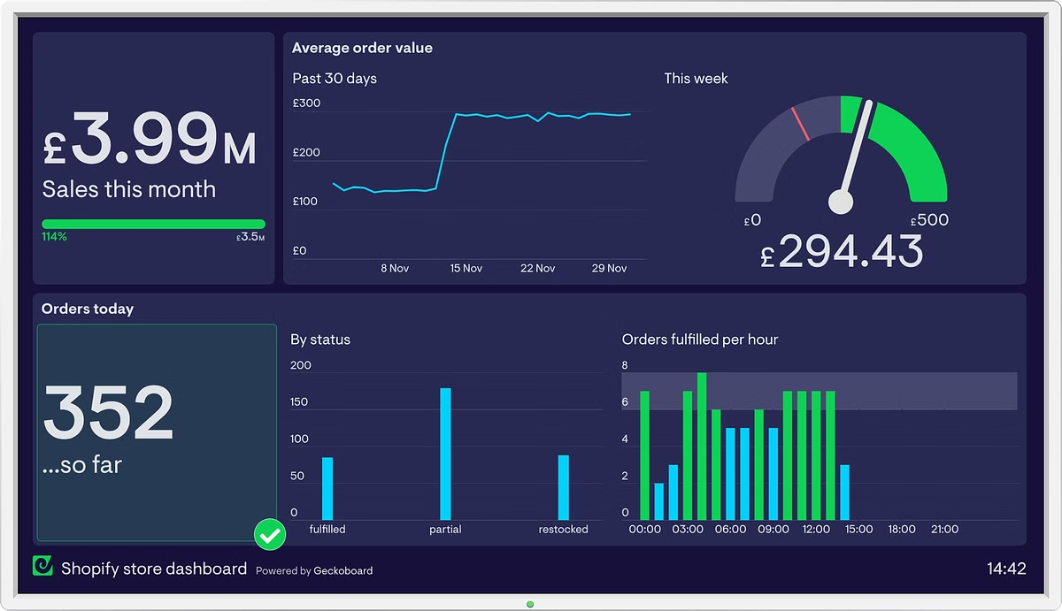


Customer Purchase Patterns and Monthly Sales Trends
Customer Purchase Patterns
Customer purchase patterns were analyzed by calculating the frequency of orders for each customer, providing insights into customer loyalty and purchasing habits.
Monthly Sales Trends
Monthly sales trends were visualized using a line chart to identify seasonal patterns, growth trends, and potential anomalies.

Slide 7
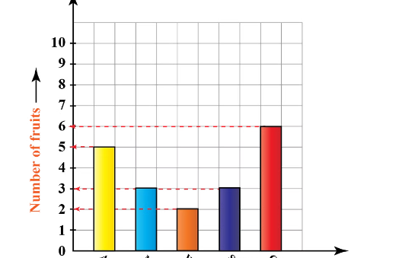
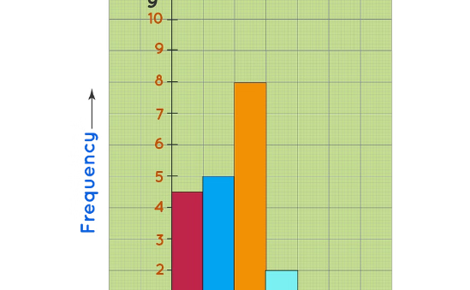
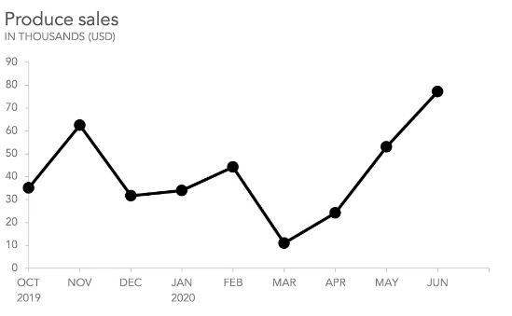

Data Visualizations
Top-Selling Products
Customer Purchase Frequency
Monthly Sales Trends
A bar chart shows the top 10 best-selling products, highlighting the most popular items in the e-commerce store. This visualization provides valuable insights into customer preferences and demand trends, allowing for informed decisions regarding product development and marketing strategies.
A histogram visualizes the distribution of customer order frequencies, indicating the number of customers who purchase at different rates. This helps understand customer loyalty and purchasing habits, enabling segmentation for targeted marketing campaigns.
A line chart illustrates the evolution of sales over time, revealing seasonal patterns, growth trends, and potential fluctuations. This visualization provides a comprehensive view of sales performance, identifying areas for improvement and opportunities for future growth.

Slide 8
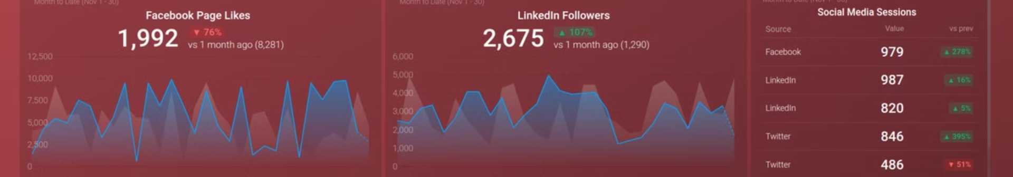

Key Insights and Findings
Total Revenue
Popular Products
The total revenue generated by the e-commerce store is a key metric, indicating the overall success of the business.
Understanding which products are selling well allows for targeted marketing efforts and stock management strategies.
Customer Behavior
Sales Trends
Analyzing customer purchase patterns provides insights into customer loyalty, preferences, and overall engagement.
Identifying sales trends over time enables the business to plan for seasonal fluctuations, optimize pricing, and anticipate future demand.

Slide 9






Recommendations and Limitations
Promote Top-Selling Products
Loyalty Programs
Highlighting the most popular products through targeted marketing campaigns can drive sales and increase revenue.
Implementing loyalty programs can encourage repeat purchases and reward frequent customers, building brand loyalty.
Inventory Planning
Data Quality Issues
Utilizing monthly sales trends to optimize inventory levels can minimize stockouts, reduce waste, and enhance operational efficiency.
Potential data quality issues could impact the accuracy and reliability of the analysis, necessitating careful data cleaning and validation.

Slide 10


Conclusion
This e-commerce sales analysis project successfully identified key insights into customer behavior, sales trends, and popular products. These insights can inform business decisions, optimize operations, and drive growth. However, it is important to acknowledge potential data quality limitations and ensure ongoing monitoring to maintain the accuracy and relevance of the findings. Thank you for your time and consideration.

